Slide 1
Personal Expense Tracker – Data Science Capstone Project
Analyzing and Predicting Personal Spending Patterns
Presented By : Aanchal Gor

Slide 2
Executive Summary
Aim: Predict potential savings based on income, expenses, lifestyle.
Dataset: Personal Expense Tracker with 19 columns.
Methodology : Data Collection -> Data Cleaning -> EDA ->SQL Analysis -> Predictive Modeling -> Dashboard & Map
Key Findings : Age , Income, City Tier affect savings ;Random Forest predicts well.
Presented By : Aanchal Gor

Slide 3
INTRODUCTION
Problem: Individuals struggle to manage finances.
Objective: Identify patterns & predict potential savings.
Relevance: Helps budget planning.
Placeholder: Optional infographic
Presented By : Aanchal Gor

Slide 4
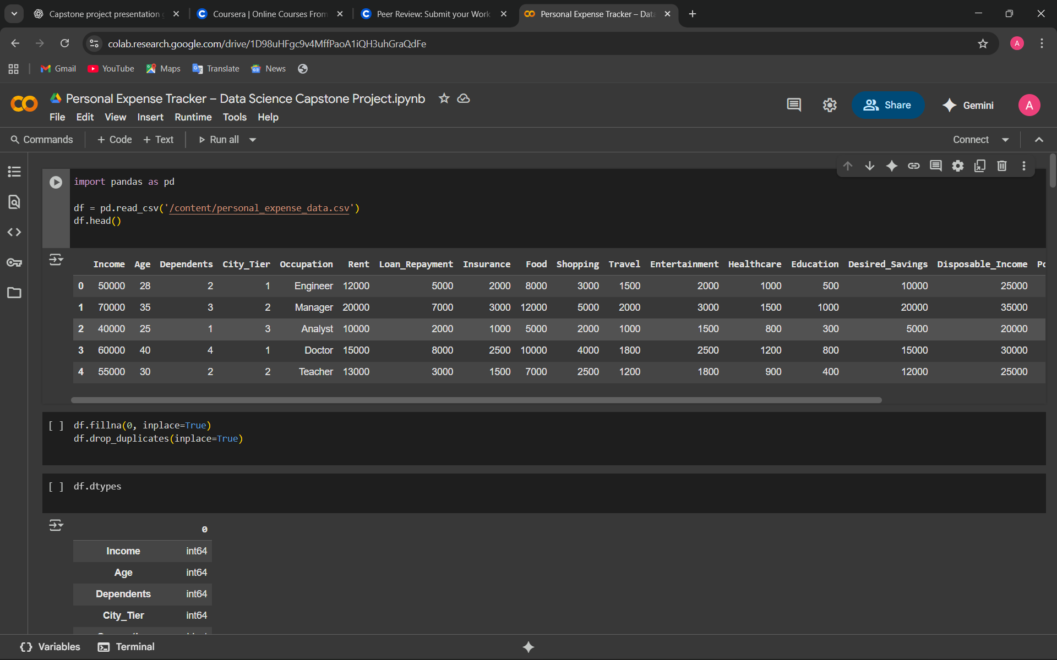
Data collection & wrangling
Data Source :- CSV FILE
Cleaning :- Handle Missing Values, drop duplicates , convert categorical
Placeholder: Table Screenshot of dataset head.
Presented By : Aanchal Gor

Slide 5
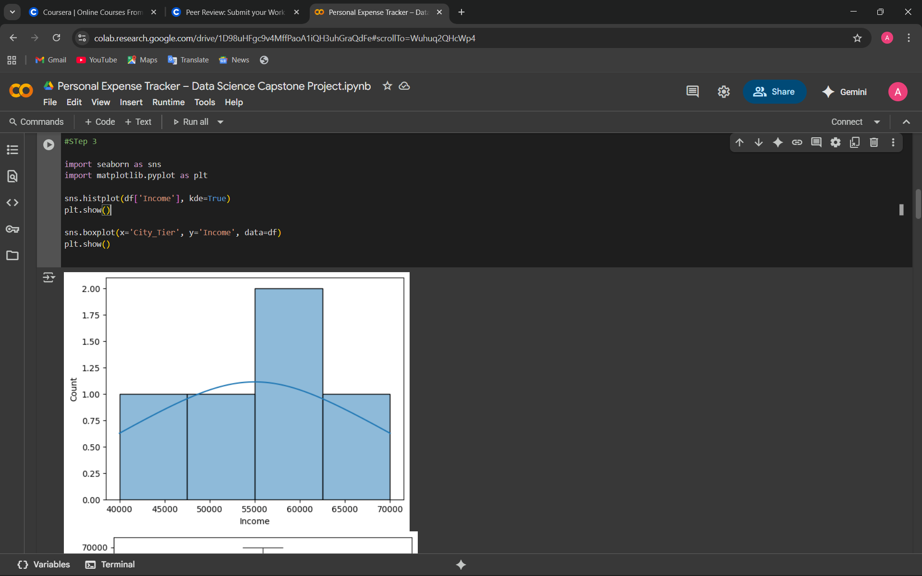
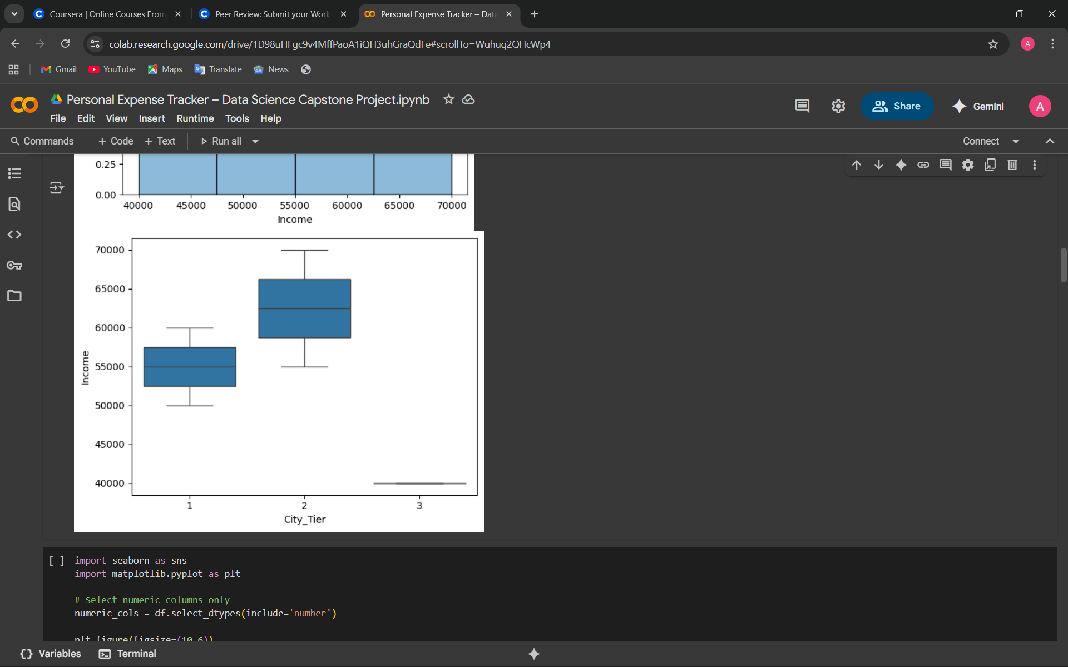
EDA & Interactive Visual Analytics
Techniques: Histograms, Boxplots, Correlation Heatmaps, Pairplots.
Insights: Income higher in City Tier 1; Age correlates with savings; Rent & Loans affect Disposable Income.
Placeholder: Include heatmap, histogram, boxplot images.
Presented By : Aanchal Gor

Slide 6
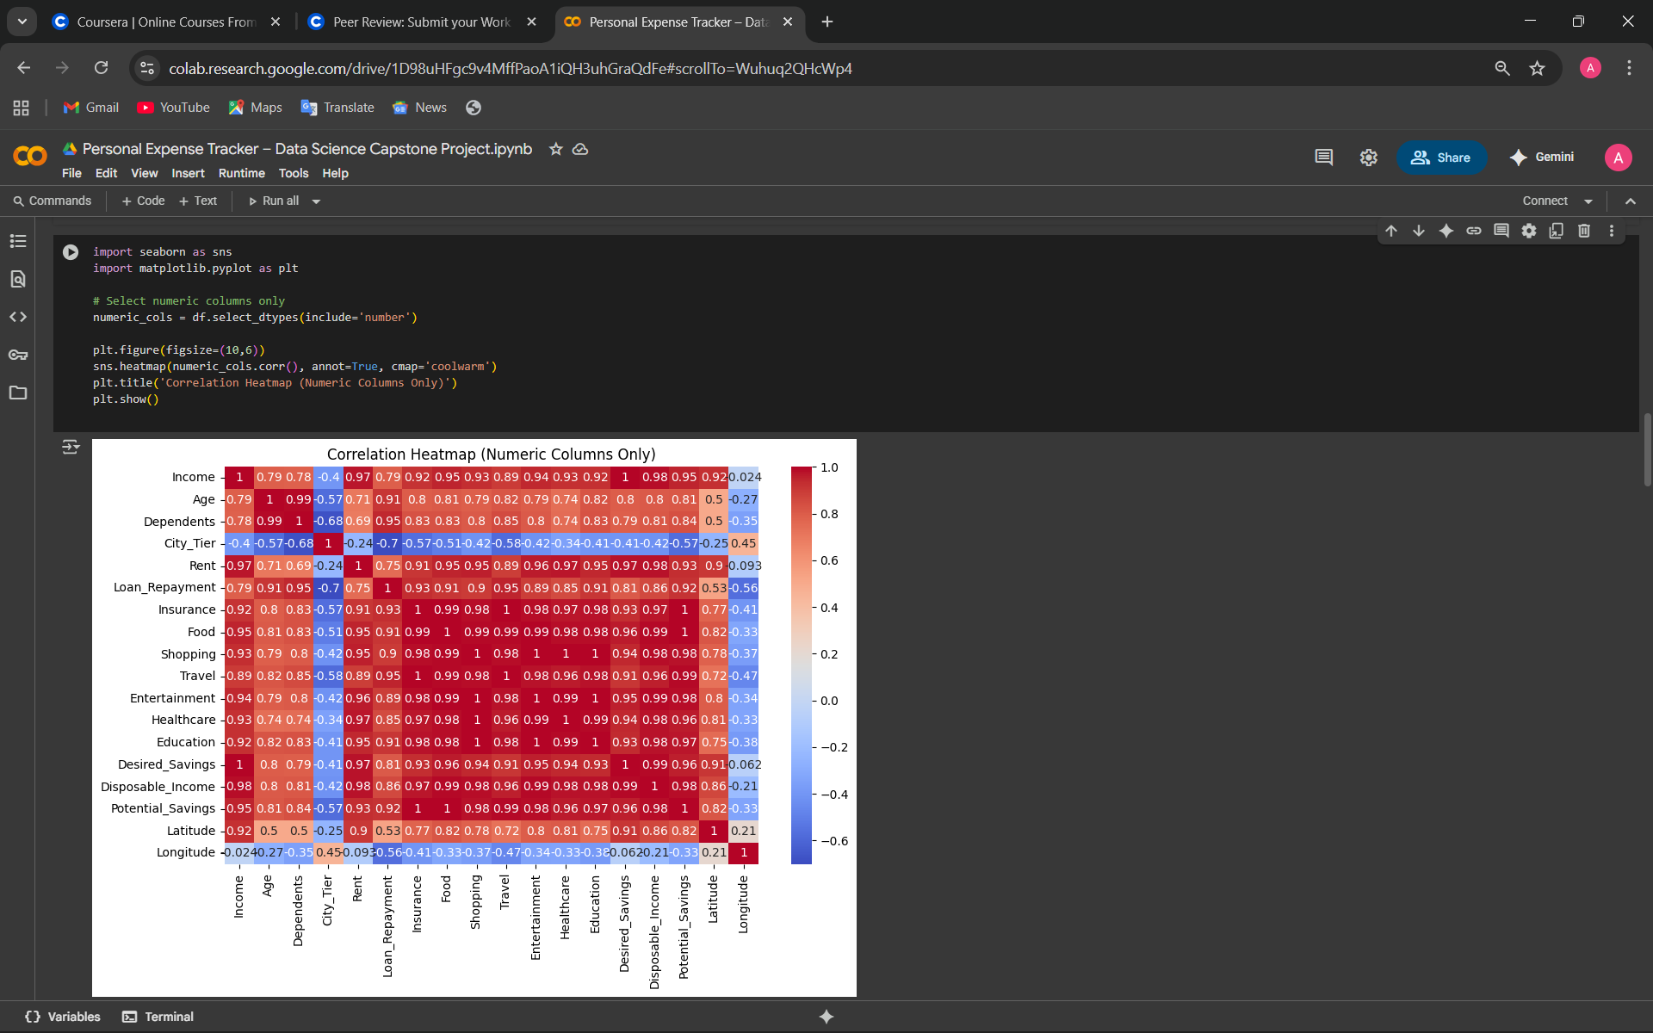
EDA & Interactive Visual Analytics
Presented By : Aanchal Gor

Slide 7
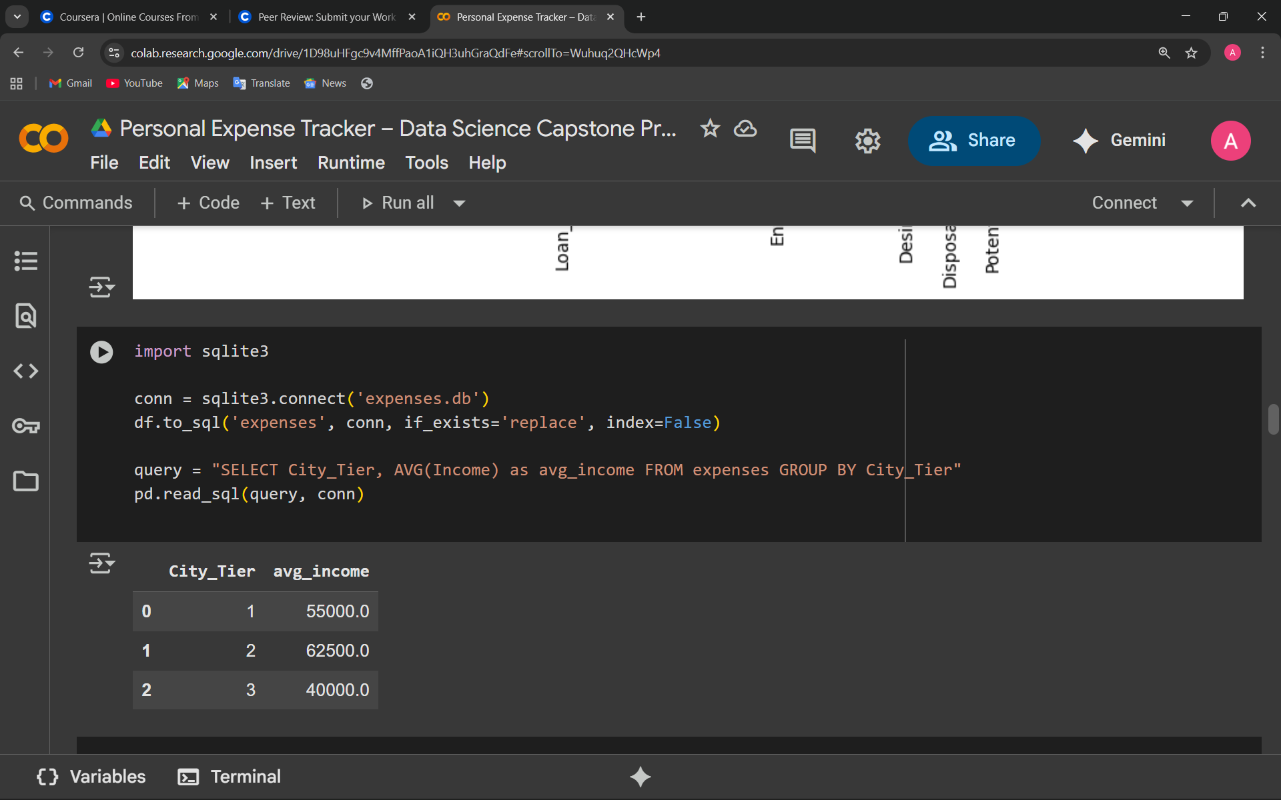
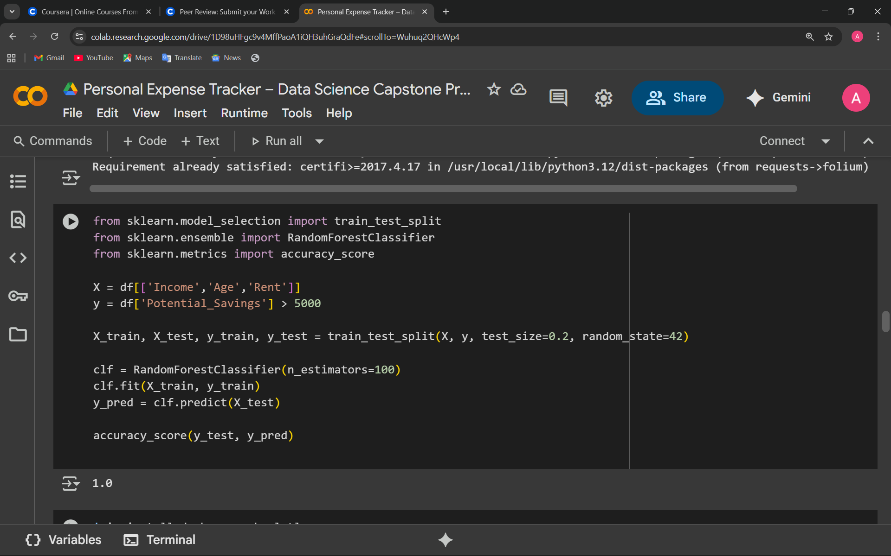
Predictive Analysis Methodology
Target: Potential_Savings > 5000 (binary).
Features: Income, Age, Rent, Dependents
Model: Random Forest
Train/Test: 80% / 20%
Performance metric: Accuracy & Confusion Matrix
Presented By : Aanchal Gor

Slide 8
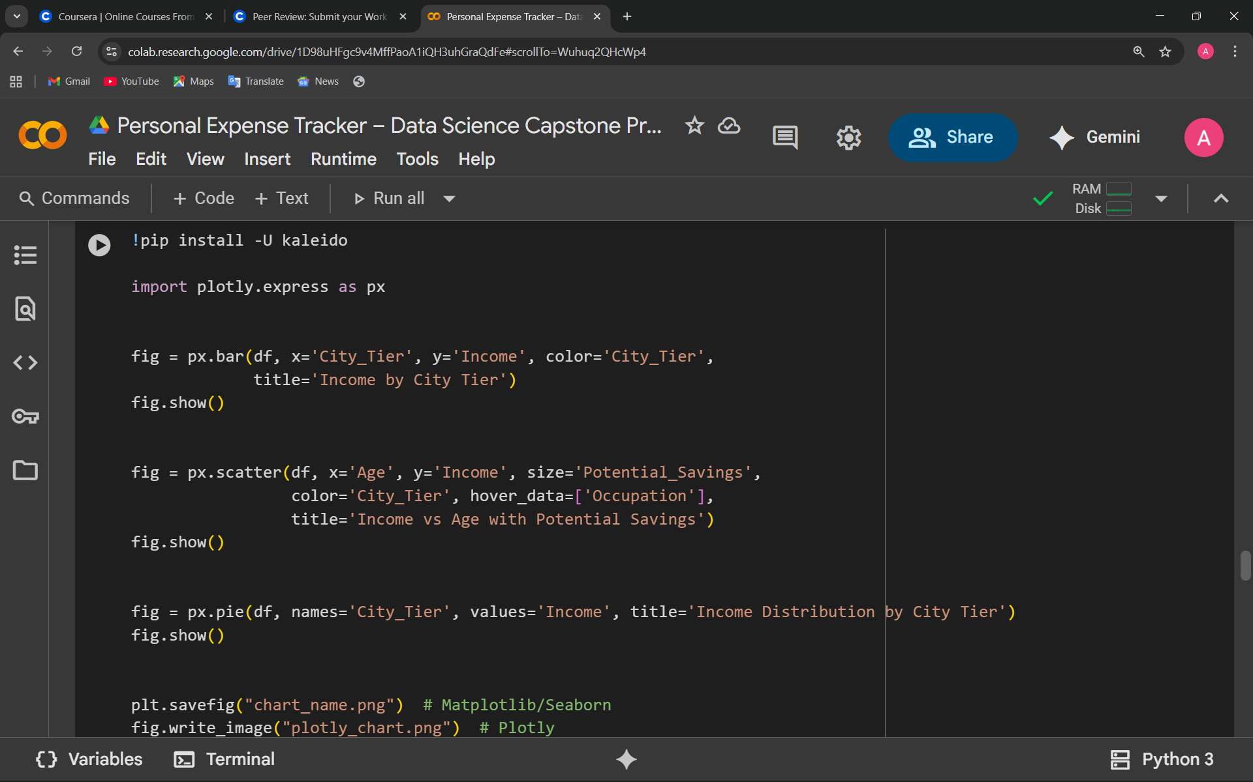
EDA with Visualization Results
Charts: Bar, Scatter, Pie, Pairplots
Insights: Income distribution, spending patterns, correlations
Placeholder: Chart screenshots
Presented By : Aanchal Gor

Slide 9
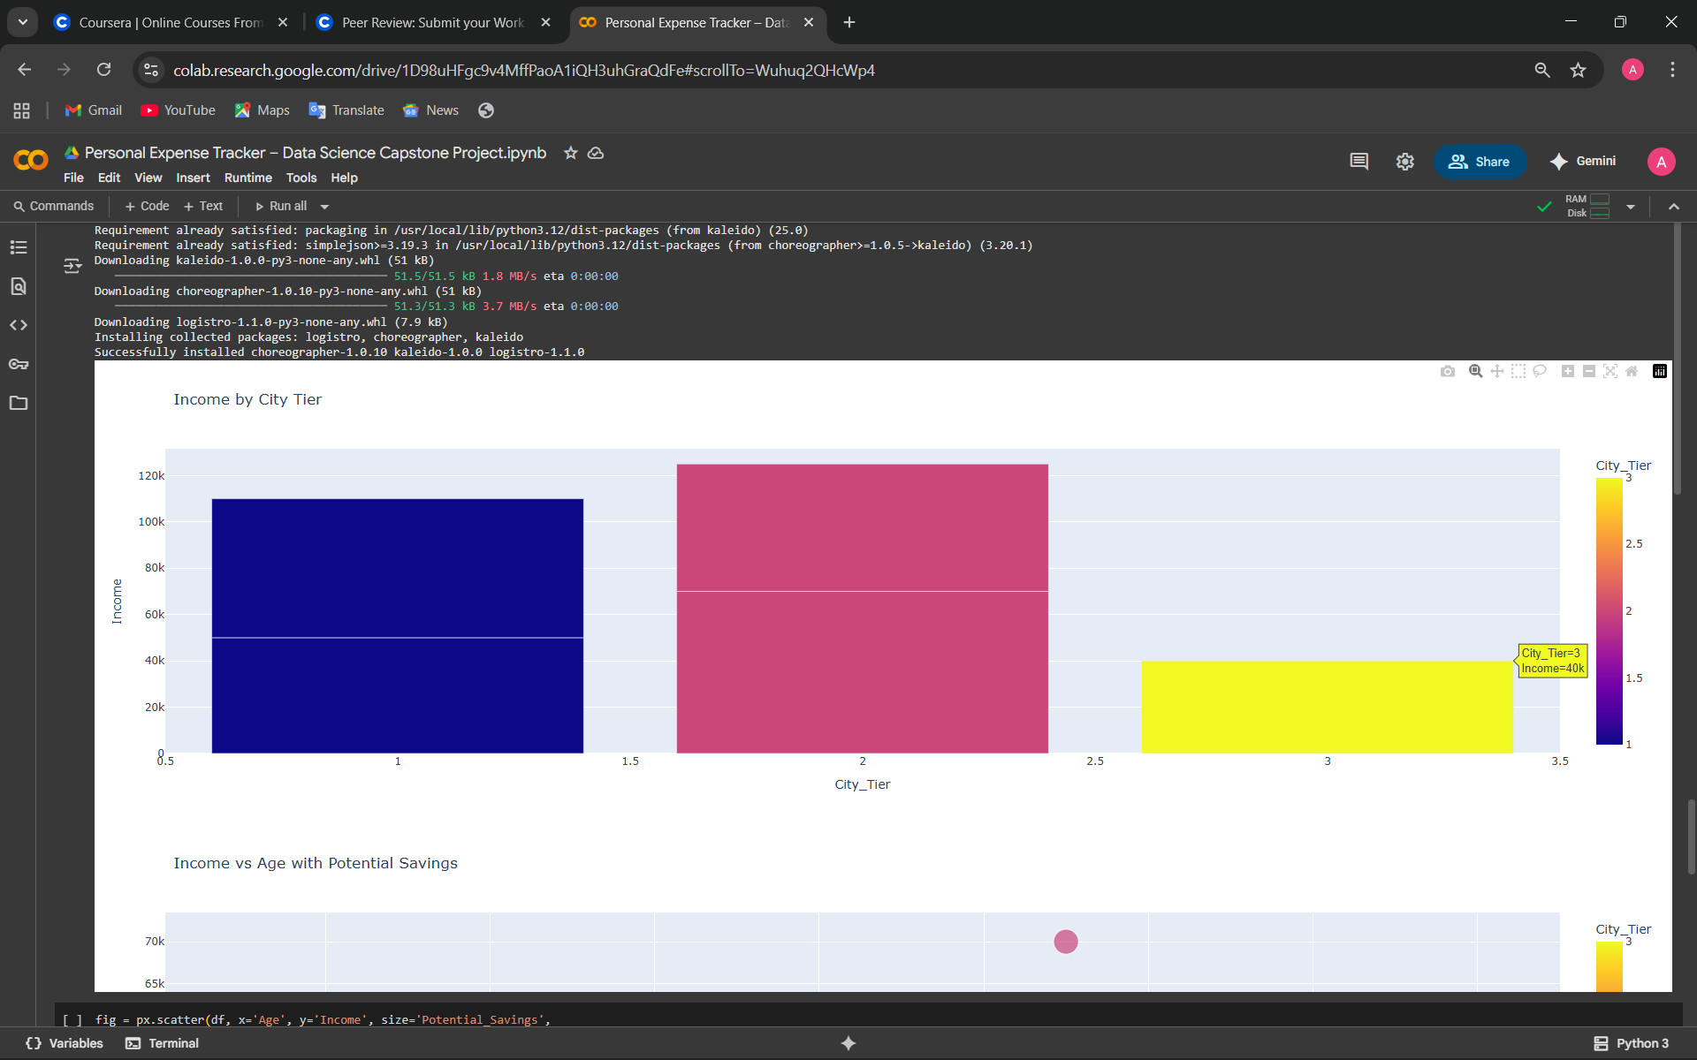
EDA with Visualization Results
Presented By : Aanchal Gor

Slide 10
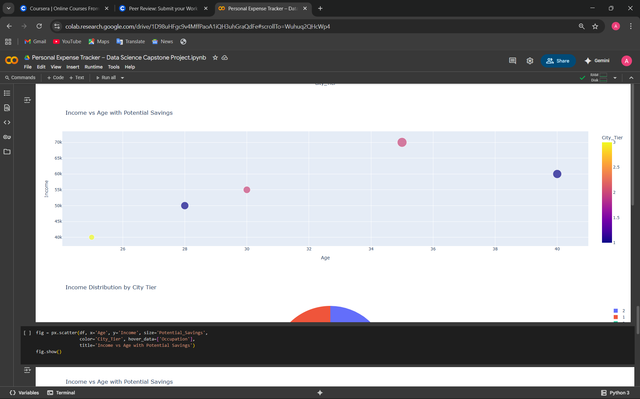
EDA with Visualization Results
Presented By : Aanchal Gor

Slide 11
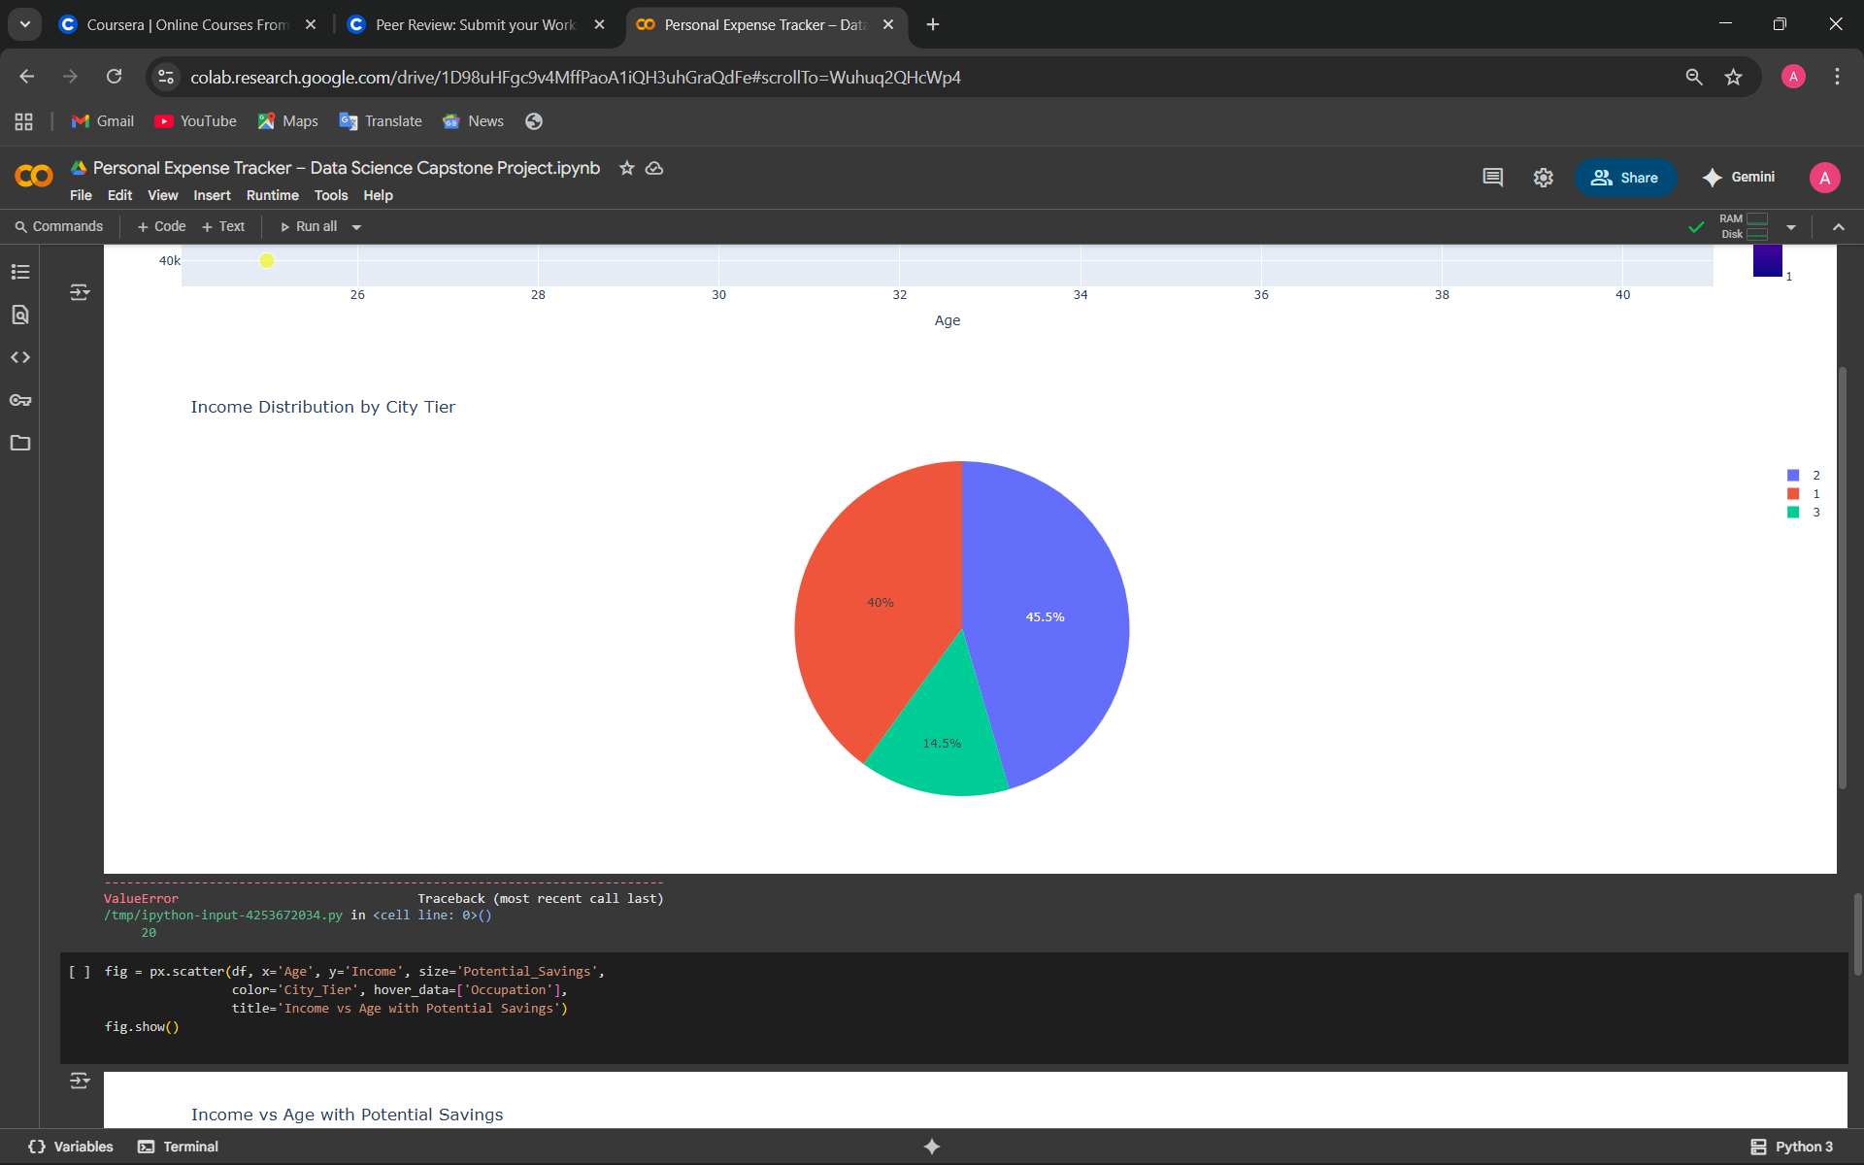
EDA with Visualization Results
Presented By : Aanchal Gor

Slide 12
FUTURE WORK
Integration with SQL Databases
Automating data collection directly from SQL databases.
Creating optimized queries for faster retrieval and preprocessing.
Advanced Predictive Modeling
Applying machine learning models (Regression, Classification, Time Series).
Using historical SQL data to improve accuracy.
Scalability & Real-Time Predictions
Building real-time dashboards connected with SQL + ML pipelines.
Enabling live predictive insights for decision-making.
Data Visualization & BI Tools
Power BI/Tableau integration with SQL + predictive models.
Interactive visual reports for better understanding.
Continuous Model Improvement
Periodic retraining using updated SQL datasets.
Feedback loop for improving prediction performance
Presented By : Aanchal Gor

Slide 13
CONCLUSION
Key Findings :- Income, Age, Rent, City Tier influence savings; dashboards/maps help understanding
Future Work: Deploy web app, include more lifestyle variables
Presented By : Aanchal Gor

Slide 14
Creativity & Innovative Insights
Extra Features: Interactive charts, Folium map, highlight patterns (e.g., students save less, doctors save more)
Future Work: Infographic of insights/trends
Presented By : Aanchal Gor

Slide 15
THANK YOU
Presented By :- Aanchal Gor

